Slide 1

ECL Intelligence System
A Retrieval-Augmented Explainable Framework for Credit Risk Analysis
Name : - Vishwajeet Kumar
College:- Birla Institute of Technology

Slide 2

Executive Summary
A fully integrated Expected Credit Loss (ECL) analytics platform combining deterministic risk modeling with RAG and RBAC for transparent, secure portfolio analysis.
14
API Endpoints
Secure routes for authentication, ECL processing, and data retrieval
Core Innovation
Explainable formula-based ECL computation aligned with regulatory expectations, accessible through natural language querying.
15-30s
Query Response
Fast RAG-driven insights with RBAC filtering

Slide 3

The Challenge
Explainability
Accessibility
Security
Avoid black-box modeling with clear, formula-based ECL computation aligned with regulatory expectations.
Enable natural language querying through RAG without requiring SQL knowledge or understanding internal data structures.
Implement RBAC ensuring analysts see only permitted segments while CROs maintain full oversight.
Using structured loan data, the system automatically performs preprocessing, segmentation, and calculation of PD, LGD, EAD, and ECL per segment—stored in Neon PostgreSQL and indexed with Pinecone for semantic retrieval.

Slide 4
Core Requirements
ECL Computation
Segmentation
RAG Interface
Explainable formula ECL = PD × LGD × EAD at segment granularity
Process Kaggle bank-loan data grouped by area, occupation, gender, purpose, home ownership, age, education
Natural-language queries over vectorized segment documents with LLM answers grounded in calculated metrics

Slide 5
Security & Operations
RBAC
History & Deployment
Enforce role-based access for all stages—Analysts see permitted segments, CRO manages permissions
Persist past ECL runs/reports with secure, low-latency public endpoints

Slide 6
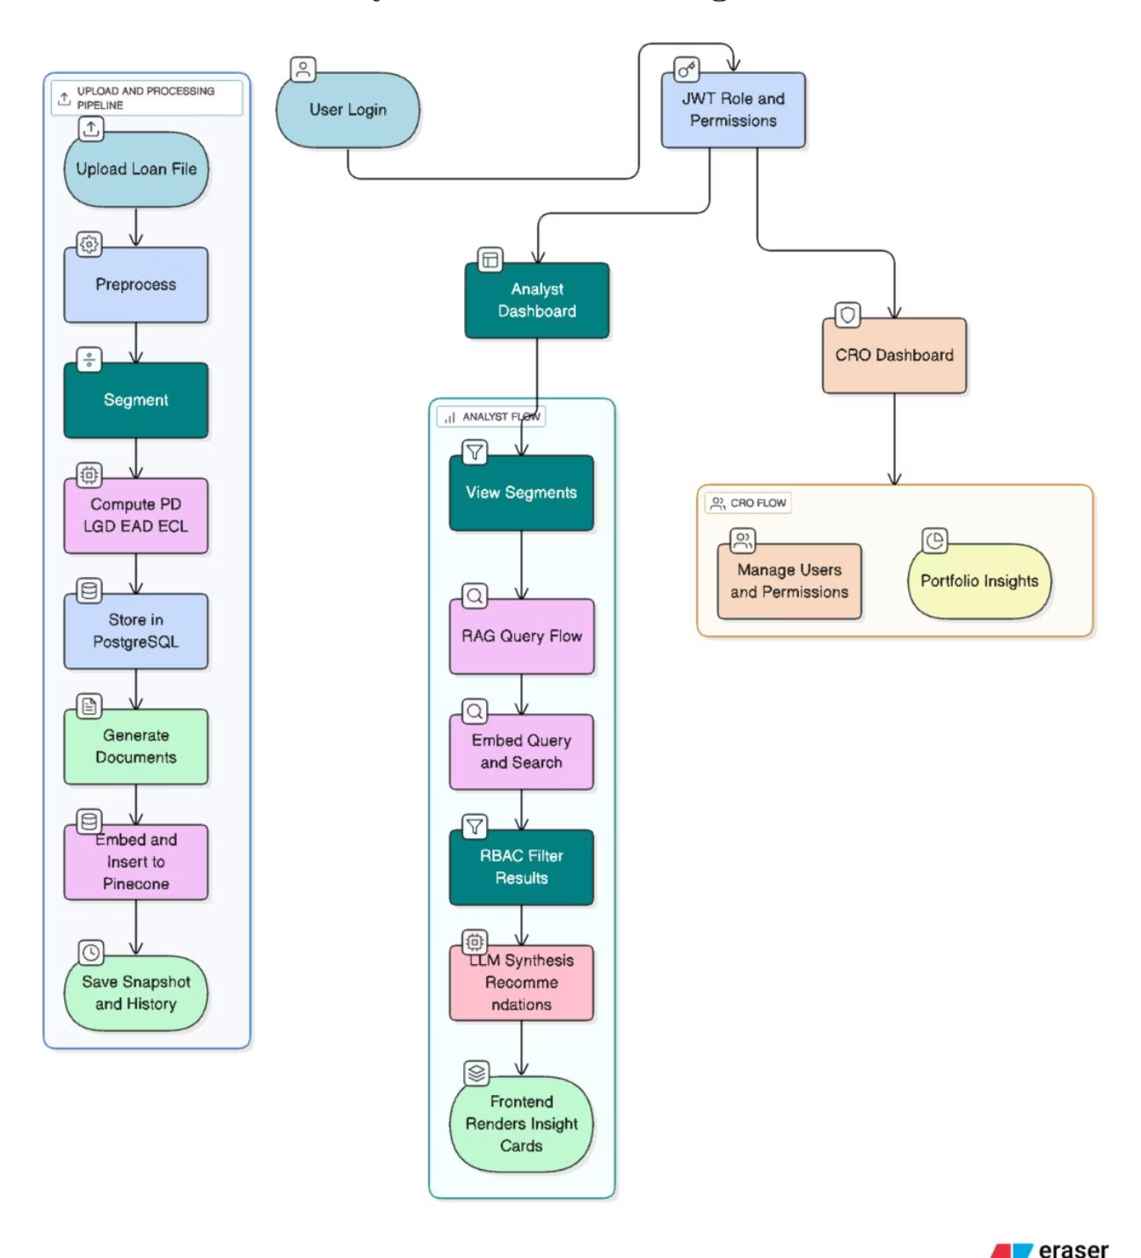
System Workflow
Authentication
Analyst/CRO logs in; backend issues JWT token
Data Upload
CSV/XLSX loan file uploaded and preprocessed
ECL Computation
PD, LGD, EAD, ECL calculated per segment
Storage & Indexing
Metrics stored in Neon, vectorized in Pinecone
Query & Insights
RAG-powered recommendations delivered to frontend

Slide 7

Architecture Overview
Client Layer
Backend Layer
Data & AI Layer
React + Tailwind
FastAPI
Neon + Pinecone + GPT-4o-mini
JWT-secured login
Authentication endpoints
PostgreSQL storage
CSV/XLSX upload
Data ingestion
ECL computation
Vector search
ECL visualization
LLM reasoning
RAG query engine
Embedding generation
RAG assistant
CRO dashboard
RBAC enforcement

Slide 8
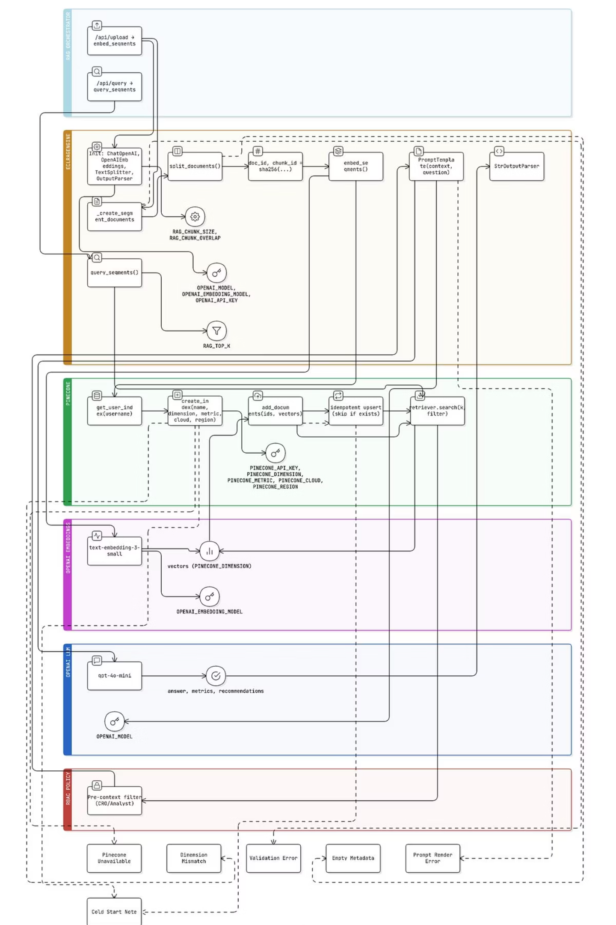
RAG Implementation
1
Per-User Index Creation
Isolated Pinecone vectors by username for multi-tenant hygiene with deterministic IDs preventing duplication
2
Document Creation
Segment metrics (PD, LGD, EAD, ECL) converted to retrievable documents with validated, rich metadata
3
Embedding & Indexing
OpenAI embeddings generated and stored in Pinecone with idempotent upsert to avoid duplicates
4
Retrieval & Prompting
RBAC-filtered context retrieved and passed to GPT-4o-mini for grounded risk interpretations

Slide 9
Challenges & Solutions
Database Schema Drift
ECL Recalculation Issues
Challenge: Schema conflicts halted uploads
Challenge: Historical data broke computation
Solution: Schema validation layer with on-demand migration, constraint retirement, and centralized transactions
Solution: Rebuilt derived features post-retrieval with safe defaults for null numerics
Pinecone Indexing Failures
RBAC Filtering Gaps
Challenge: Embeddings failed during indexing
Challenge: Overly strict filtering removed recommendations
Solution: Enforced RAG interface validation with sanitized metadata and regression tests
Solution: Fuzzy segment reconciliation with auto-seeded permissions and granular logs

Slide 10
Deployment & Security
Frontend (Vercel)
15-30s
React + Tailwind deployed globally via CDN with JWT-secured API calls and strict CORS
RAG Response Time
Low latency for complex queries
Backend (Render)
FastAPI with HTTPS, autoscaling, encrypted secrets, and health checks
100%
HTTPS Coverage
Security Architecture
All communication encrypted
JWT authentication, RBAC enforcement, RAG pre-context filtering, rate-limited endpoints

Slide 11
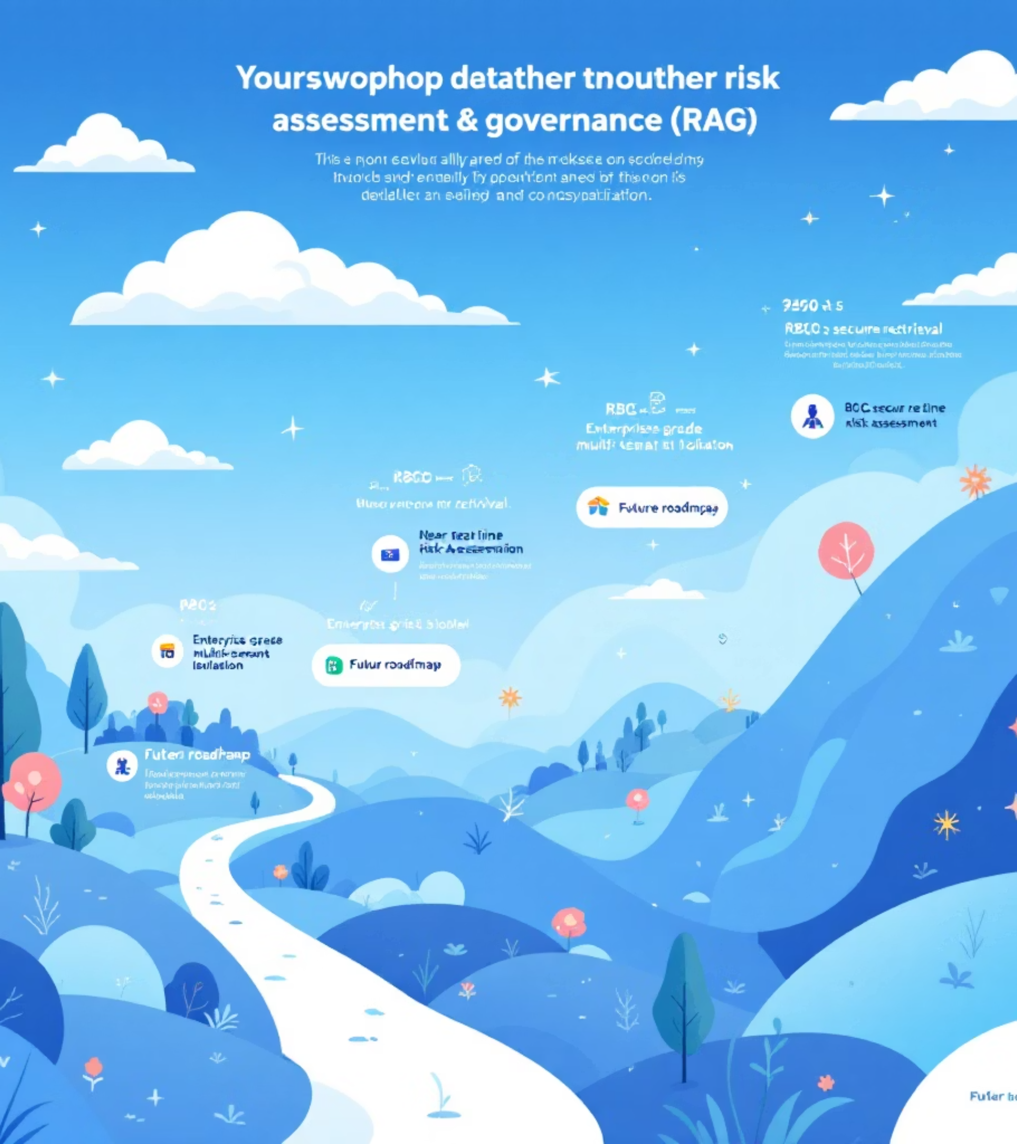
Future Roadmap
Phase 1: Enhanced RAG (Weeks 1-3)
LangGraph refactor, hybrid search, RBAC pre-context filtering, coverage scoring
Phase 2: Scalability (Weeks 3-6)
Async jobs, Parquet storage, Neon partitioning, Pinecone namespaces, caching layer
Phase 3: Compliance (Weeks 6-9)
Data Quality agents, drift detection, anomaly monitoring, cost optimization
Phase 4: Enterprise (Weeks 9-12)
Multi-tenant SSO, decisioning API, CRO approvals, automated reporting
North-Star Outcome: Trustworthy RAG with RBAC-secure retrieval, near real-time risk assessment, and enterprise-grade multi-tenant isolation.

